Slide 1
BEST PRACTICE TO REMOVE MAP COLLARS FROM ARCMAP FILES FOR GEOTIFF, KMZ, AND OTHER GEOREGISTERED USES James Amato | Wyoming State Geological Survey | February 2022

Slide 2
BACKGROUND:
We recently fulfilled a grant request to create GeoTIFF and KMZ files for previously published maps. We provided map PDFs that span across 20+ years to a 3rd party to administer this request. While the request was fulfilled, we are questioning best practices moving forwarding with the creation of these file types for future maps. We noticed on many of the GeoTIFF files that were delivered to us that there are often black collars of NoData. While the file technically works (it’s legible and georeferenced), we would like to omit these collars of no data on future map products while keeping the file size reasonable.
We've noticed that many GeoTIFFs available through the NGMDB (of old scanned USGS maps) do not have these collars of no data, and in general are very clean products with a moderate file size. I reached out to the USGS to inquire about adopting a similar SOP for creating these file types (software platform and/or extensions, georeferencing techniques, and export and compression methods used) but haven't had any luck with a response. Hoping this discussion may help shed some light on things. We have developed an SOP to create GeoTIFF’s and KMZ files, but are curious to know how other state surveys are processing these file types.

Slide 3
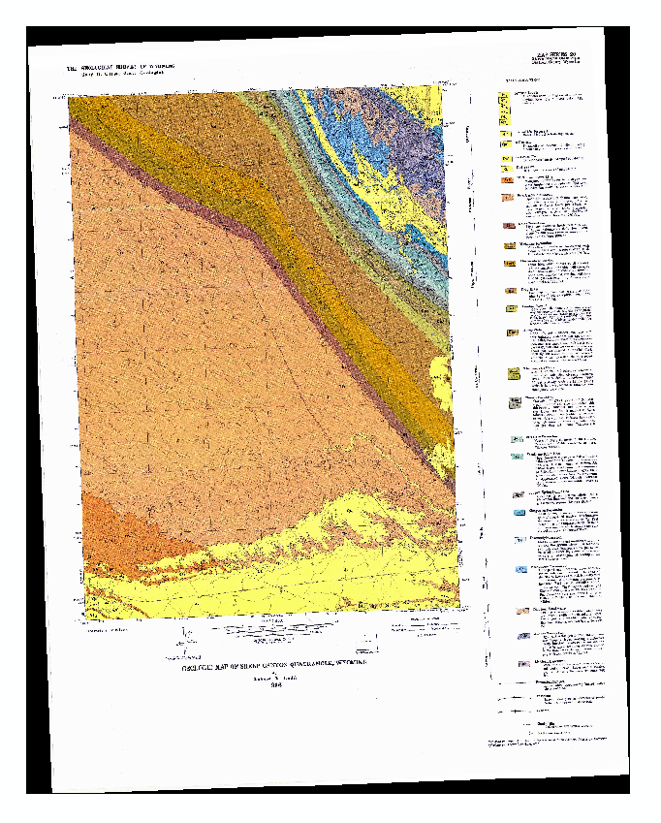
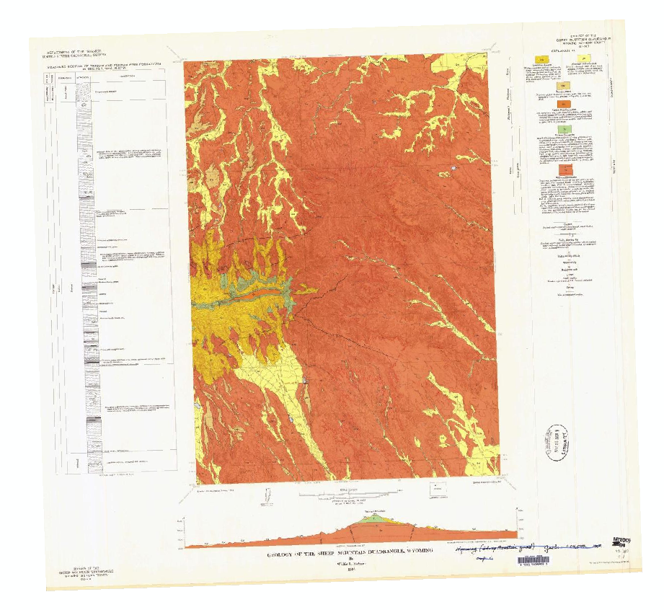
EXAMPLE:
ArcMap 10.8.1 (data view) of two 7.5 minute quadrangle GeoTIFF’s within close proximity in the same coordinate system. The one on the left shows a black collar of no data, the one on the right shows no collar and was downloaded from NGMDB.

Slide 4
MODES:
Creation of GeoTIFF and KMZ files from old map scans or PDFs:
If your starting from a printed map, you can scan the map in at a particular resolution and file format (300DPI - TIFF, JPG, PNG, PDF). If the printed map began as low resolution print out that will carry over despite scanning it at a higher resolution.
If your starting from an old PDF, your working with an unclear resolution, and may no longer have access to a working .mxd to export a higher resolution or different file format.
2. Creation of GeoTIFF and KMZ files from a working map project or .mxd:
If your starting from a working map project, you have more flexibility of exporting different file formats, resolutions, and compression settings but are also somewhat limited depending upon if you are using ArcMap or ArcPro.

Slide 5
LIMITATIONS
In ArcMap – You can only export a GeoTIFF in data view (not layout view). You can export a GeoPDF in layout view. Apparently if you have the Production Mapping License/Extension for ArcMap, it allows you the ability to export GeoTIFF’s in Layout view. My assumption is it would help resolve issues but its very expensive just to convert file types. We also have experienced difficulties using the (Layer to KML) tool in ArcMap.
ArcMap Production Mapping License:
Perpetual License: $10,000 + Annual Maintenance(Year 2): $2,500
Term License (annual payment): $4,000
In ArcPro – You can export a GeoTIFF in layout view without the cost of additional extensions. We have been successful using the (Layer to KML) tool in ArcPro.
We currently use ArcMap to layout our maps. We are hoping to make the migration to ArcPro in the years to come. We’ve been more successful creating GeoTIFFs and KMZ files in ArcPro. We have been unsuccessful trying to import are ArcMap layouts into ArcPro.

Slide 6
METHODOLOGY:
GeoTIFF:
Export a 300dpi tiff of the map layout (with no compression) + the quad boundary shapefile from ArcMap
Import tiff and quad boundary into ArcPro
Georeference tiff to corners of quad boundary and click “Save” NOT “Save As New” – the tiff file is now georeferenced (GeoTIFF).
KML/KMZ:
Geoprocessing (Layer to KML) - Layer tiff
Output scale = 1
Clamped features to ground (✔)
Return single composite image (✔)
Extent- png
Size of returned image- default(1024)
DPI of output image- default(96)

Slide 7
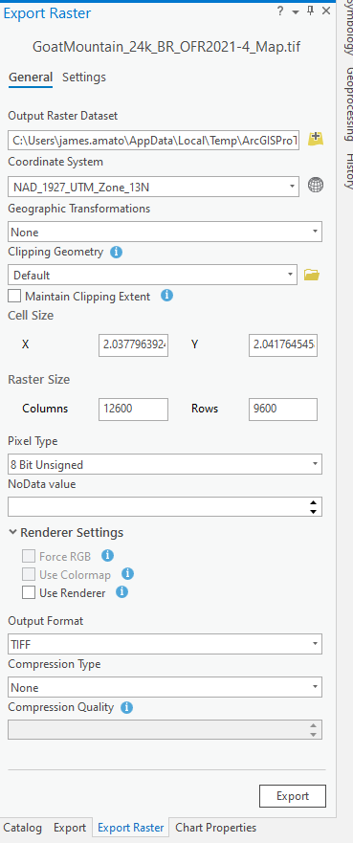
GEOTIFF CONCERNS:
This methodology results in file types with no black NoData collars, but perhaps file size is a bit excessive? Compression—If you choose to “Save As New” after georeferencing the tiff, you have the option to add compression, but the file generated always contains no data black collars, despite tweaking settings.
Work around – add compression when you export from ArcMap, but file size doesn’t reflect georef tags? Don’t export initial tiff at 300dpi? Concerns about image quality?

Slide 8
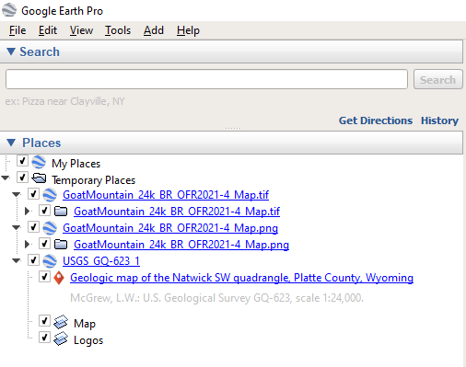
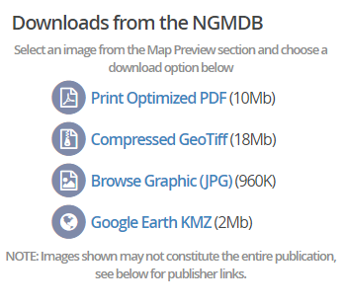
KMZ CONCERNS:
2. Using the Layer to KML tool, the output of the file is a .KMZ, but when you open it in google earth you can see the original file type the KMZ was created from. Is there a preferred file type for the creation of KMZ’s (tiff vs png)?
The Layer to KML tool doesn’t have any compression settings.
USGS KMZ = 2mb VS. 12.5 MB
Our current methodology creates tiles and appears to be in a different KMZ format than what the USGS does.

Slide 9
RECAP:
Ultimately–We’re just trying to create clean, legible map products with a moderate file size which contain no black NoData collars.
What are other state surveys doing to create these files types?
If your using ArcPro for layout, seems straight forward to create a GeoTIFF from layout view with compression?
If your using ArcMap for layout, are you using the Production Mapping License? Does it resolve these issues?
If your using Illustrator to do layout, what software are you using to creating these file types?
Anyone know what the USGS is doing to create these file types?

