Slide 1
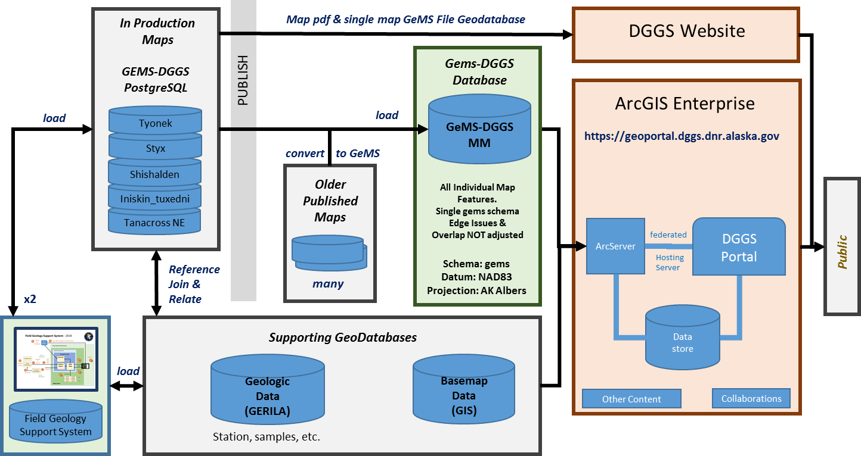
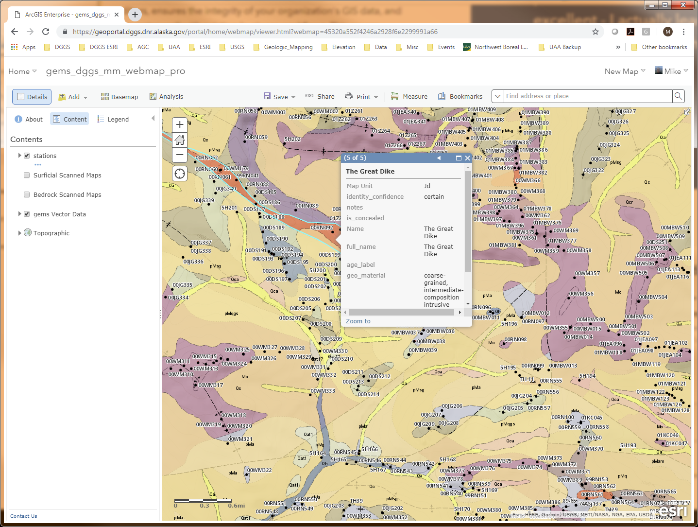
Layer Support in AK GeMS Moving Toward 3D Geologic Data 13 April 2020
Mike Hendricks, Jen Athey, Trish Ekberg, Chris Wyatt, et al
Alaska Division of Geological & Geophysical Surveys
3354 College Rd, Fairbanks AK 99709

Slide 2
Agenda
Quick Update of AK GeMS Development Status
Layer Support in AK GeMS

Slide 3
Key Aspects of AK GeMS
Greater focus on modeling Geologic Features (as opposed to graphic elements) to better support not only quality map production, but also database queries & web delivery
Based on federal GeMS standard & supports exports to this standard for delivery to USGS
Supports multiple maps in an enterprise database (PostGreSQL)
Supports multiple layers (i.e. bedrock, surficial, others)
Designed with existing AK DGGS Databases (GERILA) & Procedures in mind
Formalized Pick Lists (Attribute Domains) and Glossary
“Well” Documented

Slide 4
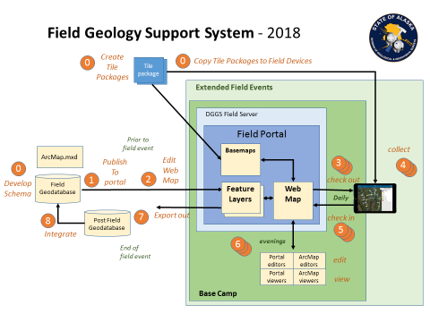
AK GeMS focused Geologic Mapping System
In Production
Maps
Map pdf & single map GeMS File Geodatabase
DGGS Website
AK GEMS
PostgreSQL
Gems-DGGS Database
PUBLISH
Converted
& loaded
GeMS-DGGS
MulitMap
ArcGIS Enterprise
load
https://geoportal.dggs.dnr.alaska.gov
AK GEMS
File GeoDB
convert
to AK GeMS
Older
Published
Maps
All Individual Map Features.
Single gems schema
Edge Issues &
Overlap NOT adjusted
Public
ArcServer
federated
DGGS
Portal
Reference
Join &
Relate
Schema: gems
Datum: NAD83
Projection: AK Albers
Hosting
Server
many
x2
Data
store
Supporting GeoDatabases
load
Geologic
Data
(GERILA)
Basemap
Data
(GIS)
Field Geology Support System
Other Content
Collaborations
Station, samples, etc.

Slide 5
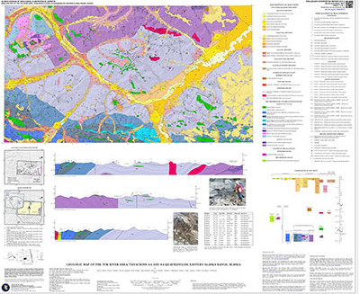
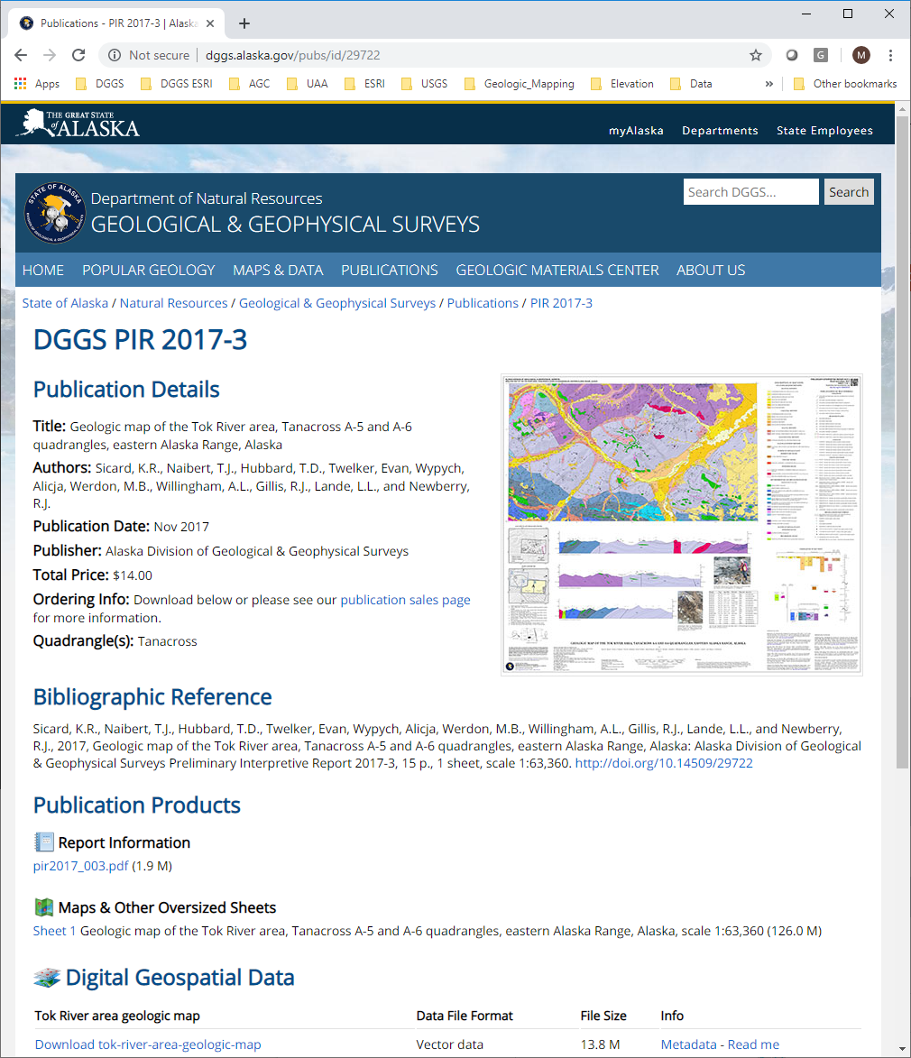
Alaska DGGS Geologic Mapping System Products
Field Event
Geodatabases
Single Map GeMS Production
Geodatabases
Multi Map GeMS
Repository Geodatabase
Alaska DGGS
Mapping
Process
Alaska DGGS
Alaska DGGS
Geologic
Feature
Services & Apps
Load
Future: Maybe
ESRI Data Interoperability
Extension?
Quality
Control
Cartographic Product
Currently Manual
Working with ESRI to develop
Data Reviewer Rule Sets & Procedures
Print, pdf,
&
Rasterize
Geologic Map
Image Service
Product Web Page
Single Map GeMS
Archive
Geodatabase
Export
Alaska DGGS
DGGS
Website
Documentation
USGS
Single Map GeMS
Archive
Geodatabase
To
USGS
Convert
Future: Maybe
ESRI Data Interoperability Extension?

Slide 6
Key Differences between AK GeMS Single Map and Multi-Map
Multi Map GeMS
Repository Geodatabase
Alaska DGGS
Geologic
Feature
Services
Load
Feature_IDs true UUID Field types (as opposed to Text) and populated with UUIDs
Domains and domain fields are type Integer
Data Sources Many-to-Many Relationship Classes built
No Cross Section Feature Datasets
No Correlation of Map Units Feature Dataset
Statewide Projection: Alaska Albers Equal Area

Slide 7
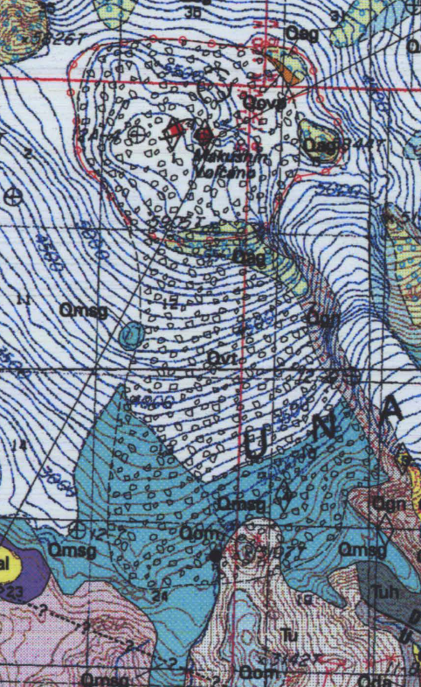
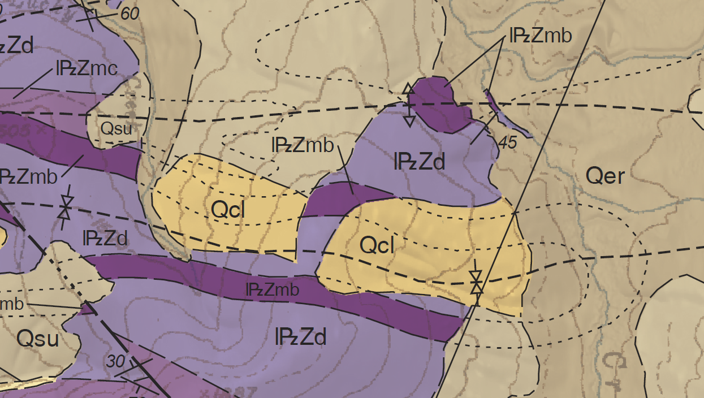
Moving Toward 3D Geologic Data Layer Support in AK GeMS

Slide 8
Currently only modeling Layers in
Map Units and their boundaries
Alaska DGGS GeMS Production GeodatabaseSchema
Cartographic
features
cartographic_polys
cartographic_lines
cartographic_points
Thematic points
station_points
geochron_points
Combined ‘map unit’ and ‘other’ overlay polys
fossil_points
= AK GeMS addition
overlay_polys
iso_lines
includes ‘generic points’
Other geologic
Info
geologic_polys
geologic_lines
geologic_points
Structure info
structure_polys
structure_lines
orientation_points
product_info
Map Units and their boundaries
contacts_and_faults
data_sources
map_unit_polys
map_unit_lines
map_unit_points
data_source_polys
descr map units
table
glossary
Geomaterial dictionary table
confidence lookup tables
symbol_info
table

Slide 9
Some of the issues
GeMs Specifies that as part of the Map Graphic the requirement for “map-unit polygons (that cover the mapped area without gaps or overlaps…”
This assumes (a) single conceptual surface being modeled, and (2) as result a geodatabase “Planar Topology” (Note the importance of Planar) can adequately check for logical inconsistencies
Cartographically as part of a “Map Graphic” this can make sense, but breaks down when attempting to generate logically consistent robust geologic data with a map that includes both bedrock and surficial units
The Topologic Rule Must not have gaps dictates that the ‘known’ bedrock polygon under surficial polygons must be deleted to ensure a valid topology
A human geologic map reader understands that the dashed hidden contacts means that the bedrock continues under the surficial unit (with some level of certainty). The current data model cannot do this.
Top of Surficial “surface”
Top of Bedrock “surface”

Slide 10
Allowing for Overlapping “Layers”
Layer field
2
Surficial Layer
Planar topology
1
Surficial Layer
Planar topology
Bedrock Layer
-1
Planar topology
Allows for additional layers as needed
Experimented with the use of the layer field set as a subtype in Arc, but currently am not employing subtypes

Slide 11
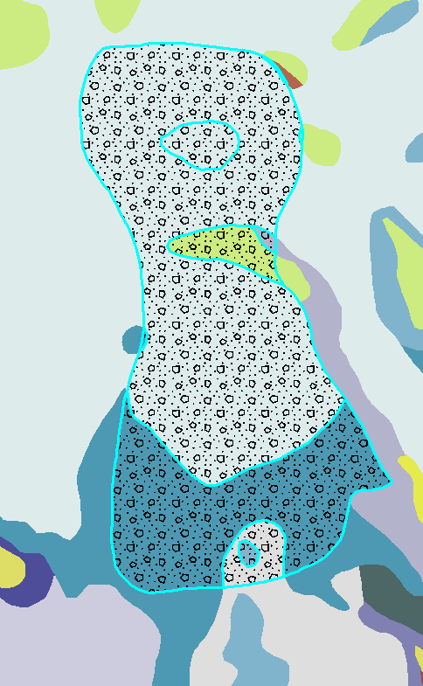
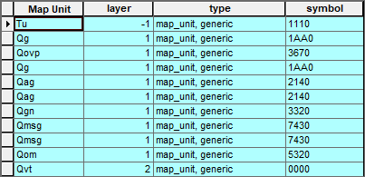
Example: A Conversion Map in Progress
1. Tephra Region stored as a map unit in layer 2
2. Pattern Draw as feature in
cartographic_polys
Note: We also added layer to DMU table

Slide 12
Contacts and Faults Layers
Challenging!
We think we can calculate contour layer from map_unit_poly’s layer value & map unit polygon topology
Concealed
N
N
Y
Y
N
N
N
Categories
B – Boundary
C – Contact
F – Fault
N
N
Category
B
C
F
C
F
C
C
C
B
Type
M
G
G
G
G
G
G
G
M
Layer
0
1
-1
-1
0
1
1
1
0
Type
M – Map
G – Generic
SB
BB
BB
SB
SB
SS
1
S1
S1
S2
SB – Surficial/Bedrock
-1
B1
B2
SS – Surficial/Surficial
BB – Bedrock/Bedrock
Alternate symbol (symbol_alt) required if switching between surficial ON or OFF

